Slide 1
Box Model
Muhammad Naeem Akhtar

Slide 2
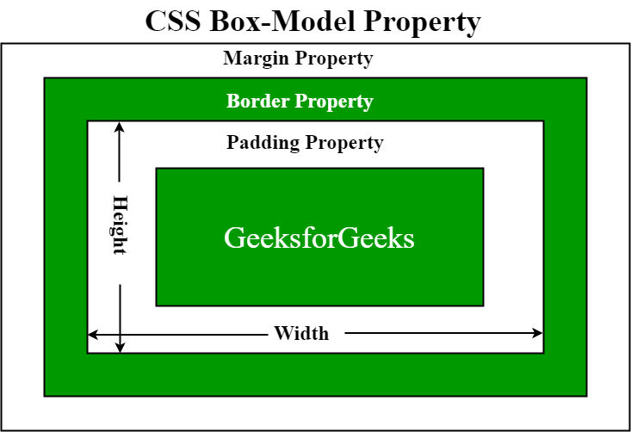
Box Model

